Slide 1
Variational Inference with Implicit Models
Dmitry Molchanov
Samsung AI Center, Samsung-HSE Laboratory

Slide 2
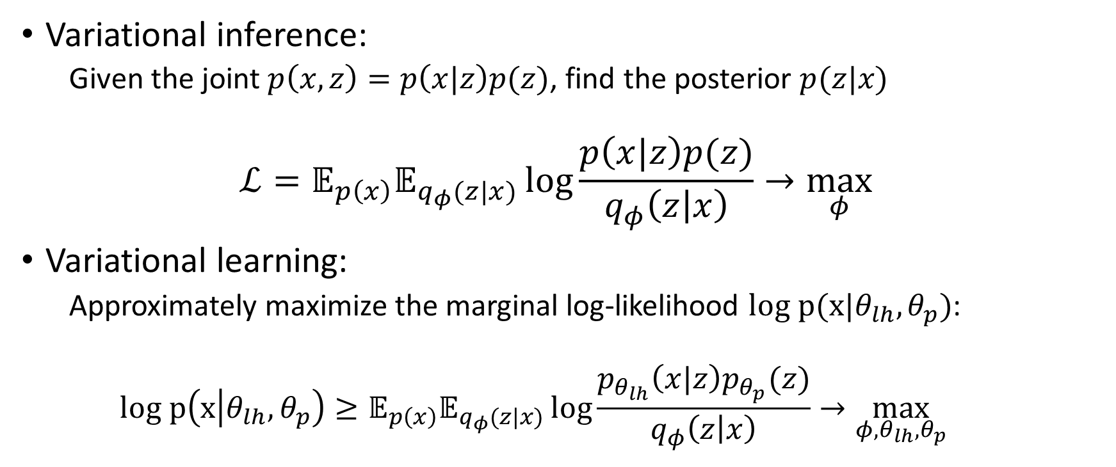
Variational inference vs variational learning
Variational inference:
Given the joint $p\left(x, z\right)=p\left(x|z\right)p(z)$, find the posterior $p(z|x)$
$$ℒ=𝔼_{p\left(x\right)}𝔼_{q_{φ}(z|x)}\log{\frac{p\left(x|z\right)p(z)}{q_{φ}\left(z | x\right)}}→\max_{φ}{ }$$
Variational learning:
Approximately maximize the marginal log-likelihood $log p(x|θ_{lh}, θ_{p})$:
$$log p\left(x | θ_{lh}, θ_{p}\right)≥𝔼_{p\left(x\right)}𝔼_{q_{φ}(z|x)}\log{\frac{p_{θ_{lh}}\left(x|z\right)p_{θ_{p}}(z)}{q_{φ}\left(z | x\right)}}→\max_{φ,θ_{lh},θ_{p}}{ }$$

Slide 3
This talk
This talk is about:
How to perform variational inference and / or learning in implicit models?
This talk is not about:
How to apply variational inference and / or learning?
How to apply implicit models?
Fancy experiments
Particular models

Slide 4
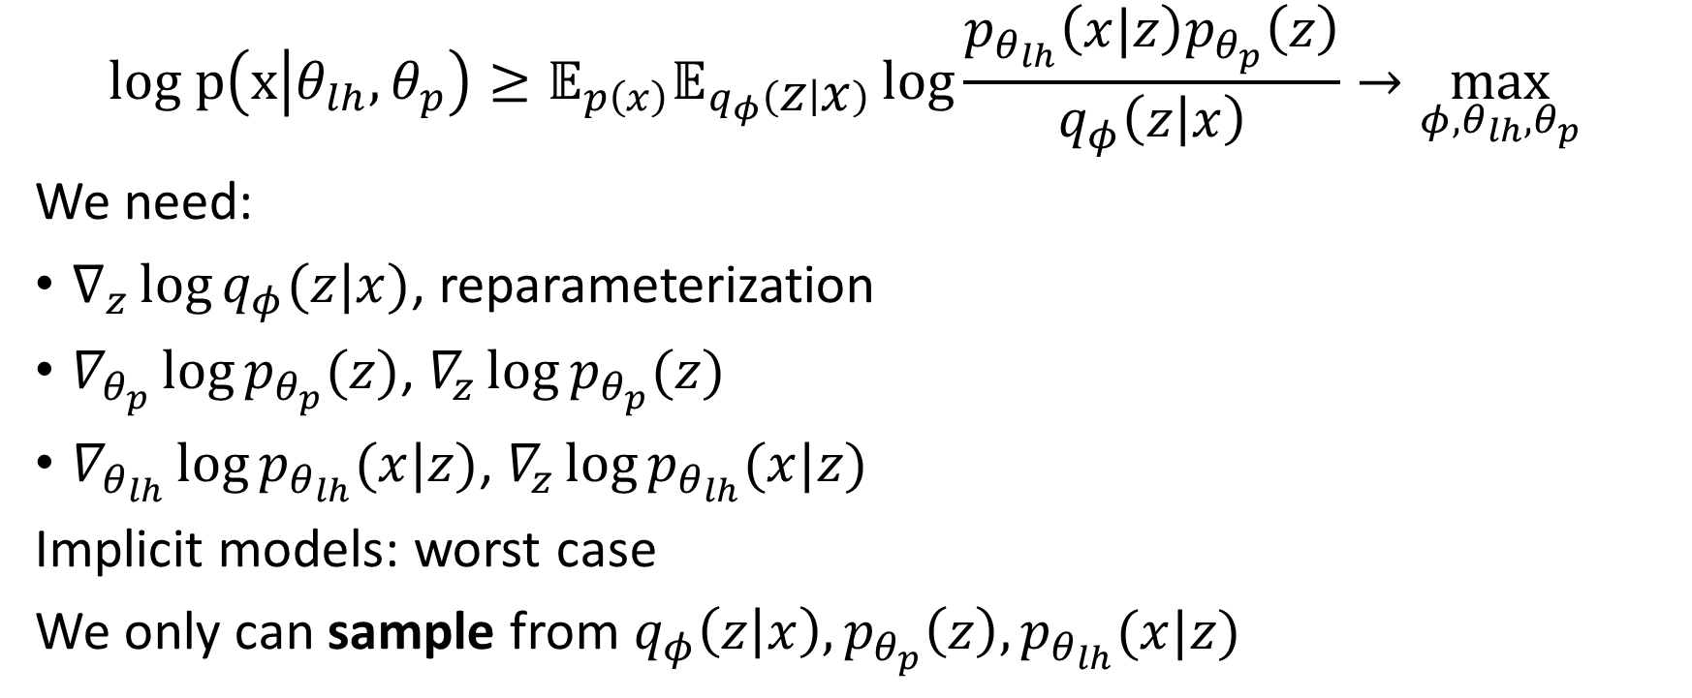
Implicit variational learning
$$log p\left(x | θ_{lh}, θ_{p}\right)≥𝔼_{p\left(x\right)}𝔼_{q_{φ}\left(z | x\right)}\log{\frac{p_{θ_{lh}}\left(x|z\right)p_{θ_{p}}\left(z\right)}{q_{φ}\left(z | x\right)}}→\max_{φ,θ_{lh},θ_{p}}{ }$$
We need:
$∇_{z}\log{q_{φ}(z|x)}$, reparameterization
$∇_{θ_{p}}\log{p_{θ_{p}}(z)}$, $∇_{z}\log{p_{θ_{p}}(z)}$
$∇_{θ_{lh}}\log{p_{θ_{lh}}(x|z)}$, $∇_{z}\log{p_{θ_{lh}}(x|z)}$
Implicit models: worst case
We only can sample from $q_{φ}\left(z | x\right), p_{θ_{p}}\left(z\right), p_{θ_{lh}}(x|z)$
Enough for variational inference (not learning)

Slide 5



Implicit posterior
Explicit posteriors are too simple (e.g. a fully-factorized Gaussian)
Exception: normalizing flows – alternative to implicit models
Arbitrary implicit generator:
$$ε$$
Neural network
$$z$$
$$x$$

Slide 6
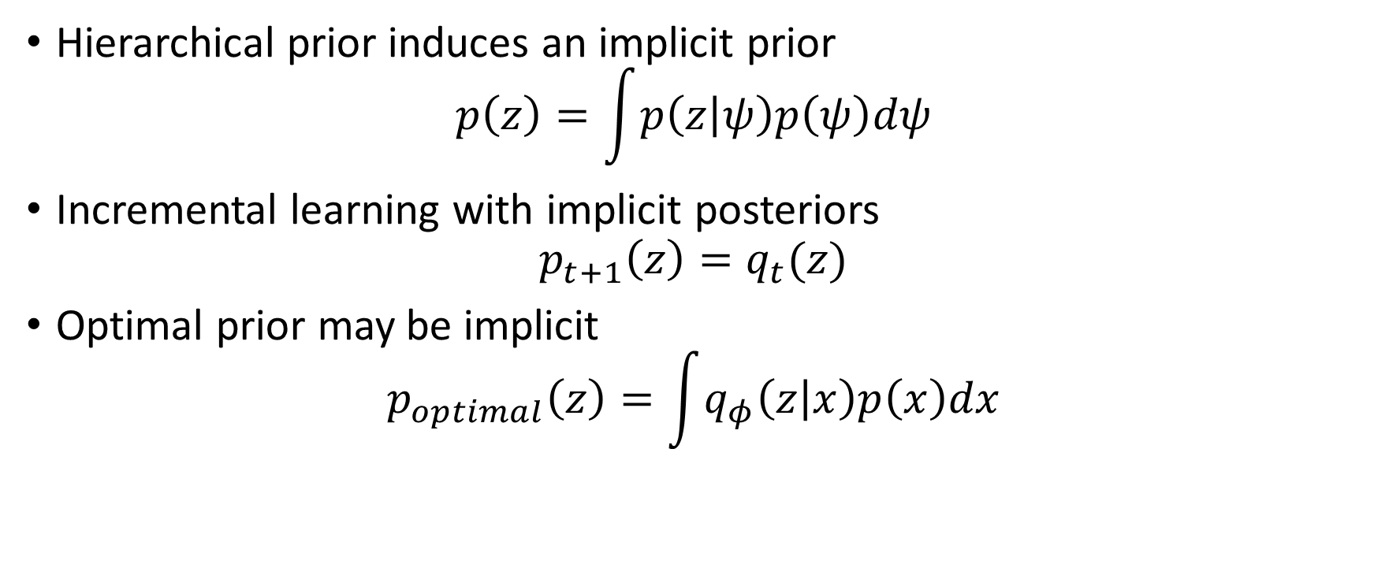
Implicit prior
Hierarchical prior induces an implicit prior
$$p\left(z\right)=\int{p\left(z | ψ\right)p\left(ψ\right)dψ}$$
Incremental learning with implicit posteriors
$$p_{t+1}\left(z\right)=q_{t}(z)$$
Optimal prior may be implicit
$$p_{optimal}\left(z\right)=\int{q_{φ}\left(z | x\right)p\left(x\right)dx}$$

Slide 7

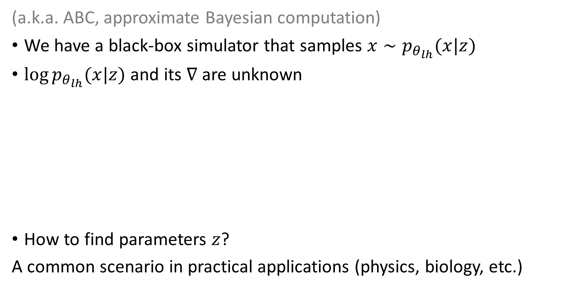


Implicit likelihood
(a.k.a. ABC, approximate Bayesian computation)
We have a black-box simulator that samples $x∼p_{θ_{lh}}(x|z)$
$\log{p_{θ_{lh}}(x|z)}$ and its $∇$ are unknown
How to find parameters $z$?
A common scenario in practical applications (physics, biology, etc.)
Parameters
$$z$$
Black-box
simulation
$$x$$
Target
Random state
$$ε$$

Slide 8
Approches to implicit modelling
Discriminator-based density ratio estimation
Approaches based on reverse models
Hierarchical variational inference
Unbiased implicit variational inference
Denoising-based inference
Other approaches (not mentioned here):
SIVI (semi-implicit VI)
KIVI (kernel implicit VI)
OPVI (operator VI)
…

Slide 9
Why these approaches?
Discriminator-based density ratio estimation
The most wide-spread
The most general approach
Hierarchical variational inference
The most simple approach
Unbiased implicit variational inference
Finally feels like “the right way to do it”
Denoiser-based gradient estimation
An unexpected beautiful result

Slide 10
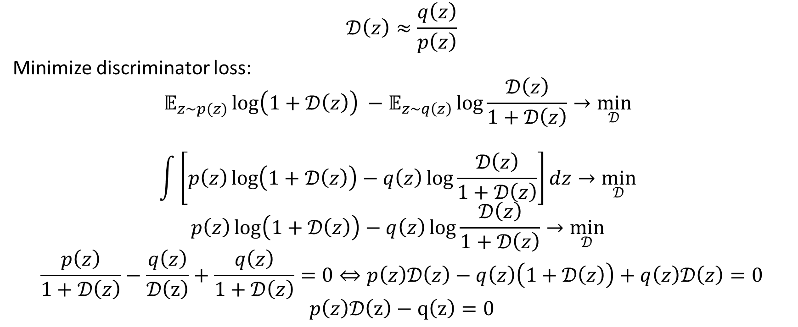
Discriminator-based density ratio estimation
$$𝒟\left(z\right)≈\frac{q\left(z\right)}{p\left(z\right)}$$
Minimize discriminator loss:
$$𝔼_{z∼p(z)}\log\left(1+𝒟\left(z\right)\right) −𝔼_{z∼q\left(z\right)}\log{\frac{𝒟\left(z\right)}{1+𝒟\left(z\right)}}→\min_{𝒟}{ }$$
$$\int{\left[p\left(z\right)\log\left(1+𝒟\left(z\right)\right)−q\left(z\right)\log{\frac{𝒟\left(z\right)}{1+𝒟\left(z\right)}}\right]dz}→\min_{𝒟}{ }$$
$$p\left(z\right)\log\left(1+𝒟\left(z\right)\right)−q\left(z\right)\log{\frac{𝒟\left(z\right)}{1+𝒟\left(z\right)}}→\min_{𝒟}{ }$$
$$\frac{p\left(z\right)}{1+𝒟\left(z\right)}−\frac{q\left(z\right)}{𝒟\left(z\right)}+\frac{q\left(z\right)}{1+𝒟\left(z\right)}=0⇔p\left(z\right)𝒟\left(z\right)−q\left(z\right)\left(1+𝒟\left(z\right)\right)+q\left(z\right)𝒟\left(z\right)=0$$
$$p\left(z\right)𝒟\left(z\right)−q\left(z\right)=0$$

Slide 11

Discriminator-based density ratio estimation
Variational learning / inference is optimization of ELBO
ELBO consists of expected log-density-ratios
Intractable $⇒$ train a discriminator to approximate density ratio

Slide 12

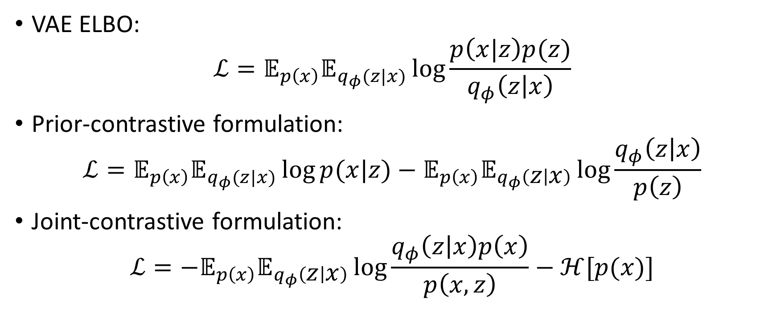

Prior-contrastive vs joint-contrastive inference
VAE ELBO:
$$ℒ=𝔼_{p\left(x\right)}𝔼_{q_{φ}(z|x)}\log{\frac{p\left(x|z\right)p(z)}{q_{φ}\left(z | x\right)}}$$
Prior-contrastive formulation:
$$ℒ=𝔼_{p\left(x\right)}𝔼_{q_{φ}(z|x)}\log{p(x|z)}−𝔼_{p\left(x\right)}𝔼_{q_{φ}\left(z | x\right)}\log{\frac{q_{φ}\left(z | x\right)}{p\left(z\right)}}$$
Joint-contrastive formulation:
$$ℒ=−𝔼_{p\left(x\right)}𝔼_{q_{φ}\left(z | x\right)}\log{\frac{q_{φ}\left(z | x\right)p\left(x\right)}{p\left(x,z\right)}}−ℋ[p(x)]$$
$$\text{KL}(q\left(z | x\right)‖p(z))$$
$$\text{KL}(q\left(z | x\right)p(x)‖p(x,z))$$

Slide 13

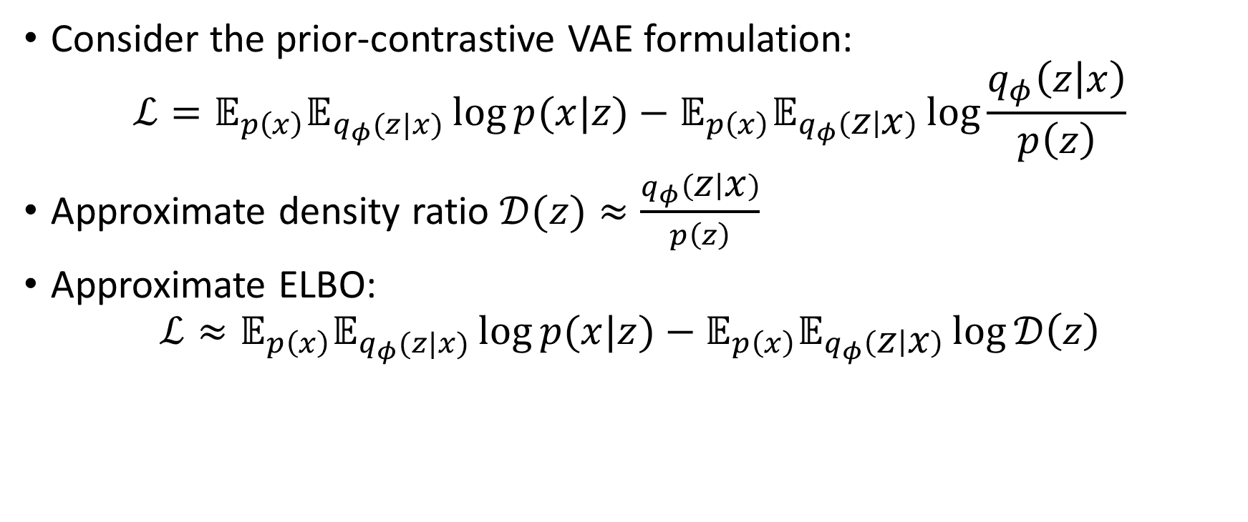
Prior-constrastive adversarial
Consider the prior-contrastive VAE formulation:
$$ℒ=𝔼_{p\left(x\right)}𝔼_{q_{φ}(z|x)}\log{p(x|z)}−𝔼_{p\left(x\right)}𝔼_{q_{φ}\left(z | x\right)}\log{\frac{q_{φ}\left(z | x\right)}{p\left(z\right)}}$$
Approximate density ratio $𝒟(z)≈\frac{q_{φ}\left(z | x\right)}{p\left(z\right)}$
Approximate ELBO:
$$ℒ≈𝔼_{p\left(x\right)}𝔼_{q_{φ}(z|x)}\log{p(x|z)}−𝔼_{p\left(x\right)}𝔼_{q_{φ}\left(z | x\right)}\log{𝒟\left(z\right)}$$
Implicitly depends on $φ$ and $θ_{p}$!

Slide 14
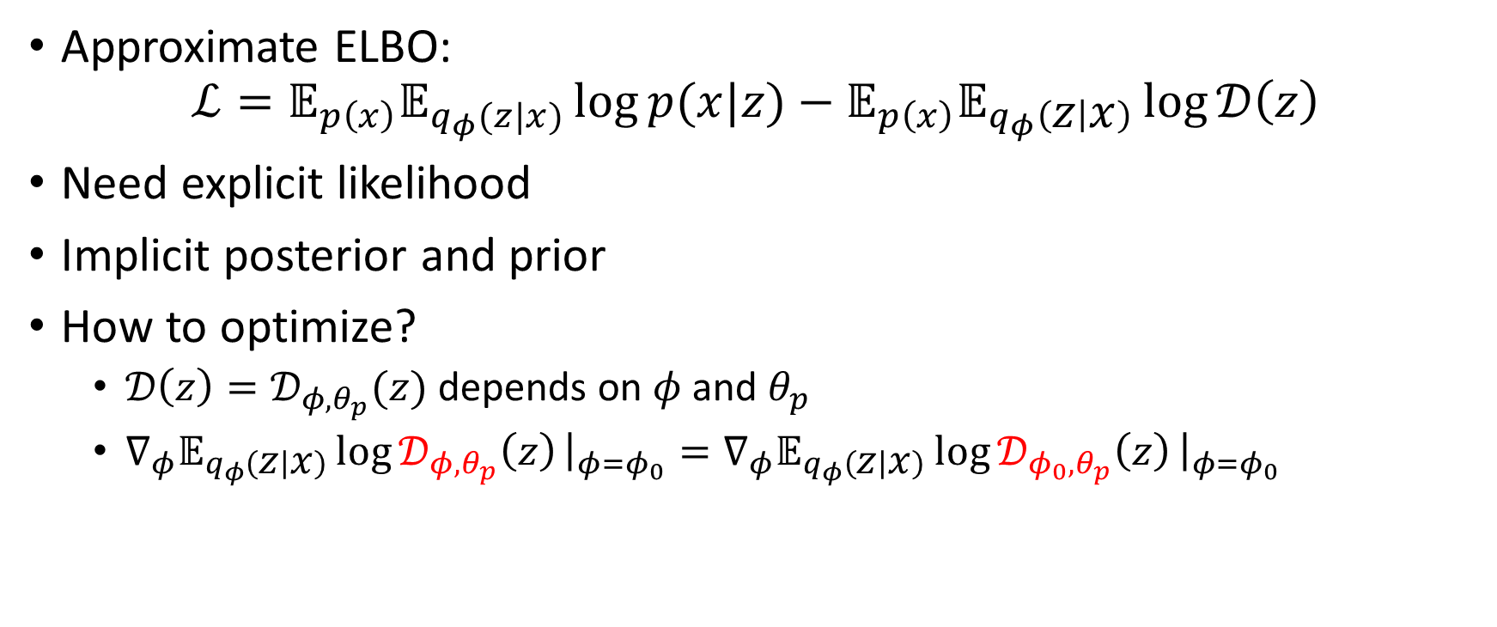
Prior-constrastive adversarial
Approximate ELBO:
$$ℒ=𝔼_{p\left(x\right)}𝔼_{q_{φ}(z|x)}\log{p(x|z)}−𝔼_{p\left(x\right)}𝔼_{q_{φ}\left(z | x\right)}\log{𝒟\left(z\right)}$$
Need explicit likelihood
Implicit posterior and prior
How to optimize?
$𝒟\left(z\right)=𝒟_{φ,θ_{p}}(z)$ depends on $φ$ and $θ_{p}$
$∇_{φ}𝔼_{q_{φ}\left(z | x\right)}\log{𝒟_{φ,θ_{p}}\left(z\right)}{\left.​\right|}_{φ=φ_{0}}=∇_{φ}𝔼_{q_{φ}\left(z | x\right)}\log{𝒟_{φ_{0},θ_{p}}\left(z\right)}{\left.​\right|}_{φ=φ_{0}}$

Slide 15
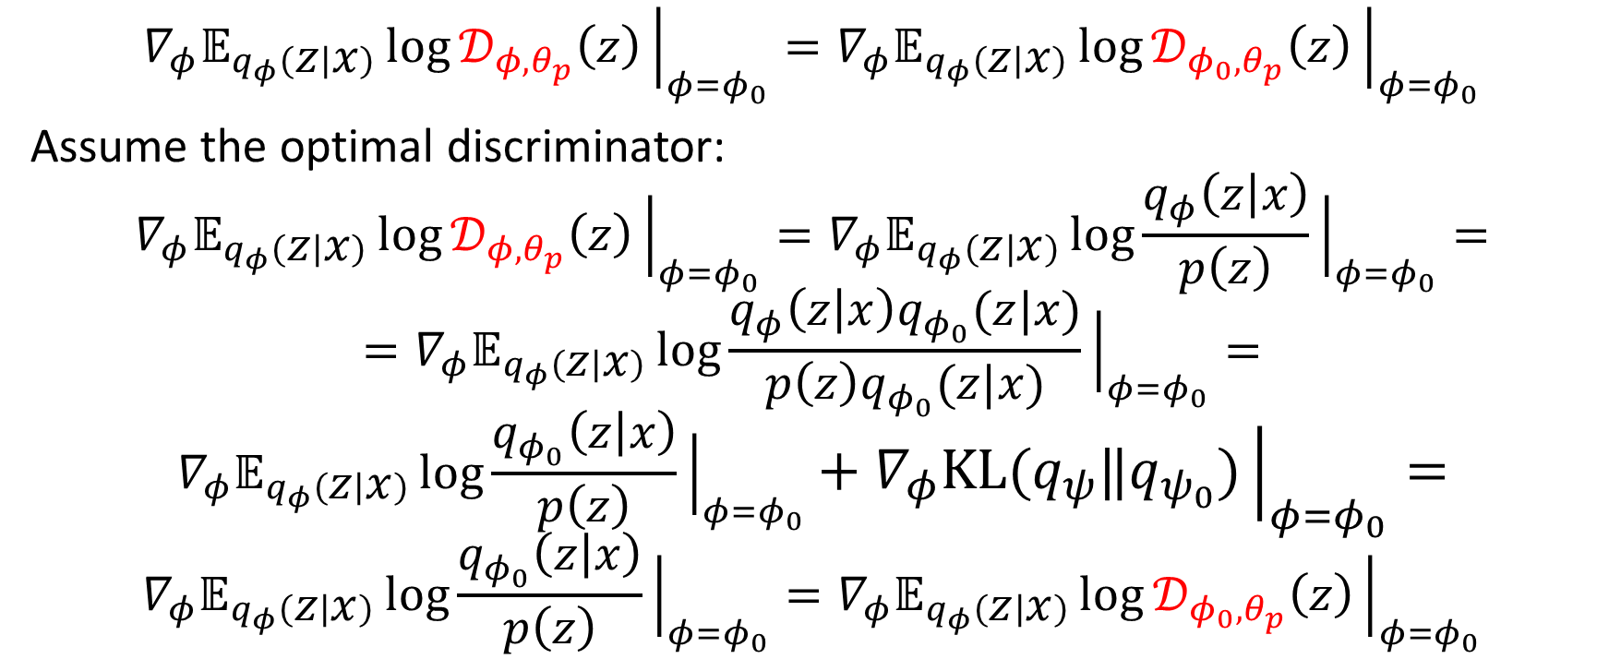
Prior-contrastive adversarial
$$∇_{φ}𝔼_{q_{φ}\left(z | x\right)}\log{𝒟_{φ,θ_{p}}\left(z\right)}{\left.​\right|}_{φ=φ_{0}}=∇_{φ}𝔼_{q_{φ}\left(z | x\right)}\log{𝒟_{φ_{0},θ_{p}}\left(z\right)}{\left.​\right|}_{φ=φ_{0}}$$
Assume the optimal discriminator:
$$∇_{φ}𝔼_{q_{φ}\left(z | x\right)}\log{𝒟_{φ,θ_{p}}\left(z\right)}{\left.​\right|}_{φ=φ_{0}}=∇_{φ}𝔼_{q_{φ}\left(z | x\right)}\log{\frac{q_{φ}\left(z | x\right)}{p\left(z\right)}}{\left.​\right|}_{φ=φ_{0}}=$$
$$=∇_{φ}𝔼_{q_{φ}\left(z | x\right)}\log{\frac{q_{φ}\left(z | x\right)q_{φ_{0}}(z|x)}{p\left(z\right)q_{φ_{0}}(z|x)}}{\left.​\right|}_{φ=φ_{0}}=$$
$$∇_{φ}𝔼_{q_{φ}\left(z | x\right)}\log{\frac{q_{φ_{0}}\left(z | x\right)}{p\left(z\right)}}{\left.​\right|}_{φ=φ_{0}}+∇_{φ}\text{KL}(q_{ψ}‖q_{ψ_{0}}){\left.​\right|}_{φ=φ_{0}}=$$
$$∇_{φ}𝔼_{q_{φ}\left(z | x\right)}\log{\frac{q_{φ_{0}}\left(z | x\right)}{p\left(z\right)}}{\left.​\right|}_{φ=φ_{0}}=∇_{φ}𝔼_{q_{φ}\left(z | x\right)}\log{𝒟_{φ_{0},θ_{p}}\left(z\right)}{\left.​\right|}_{φ=φ_{0}}$$

Slide 16
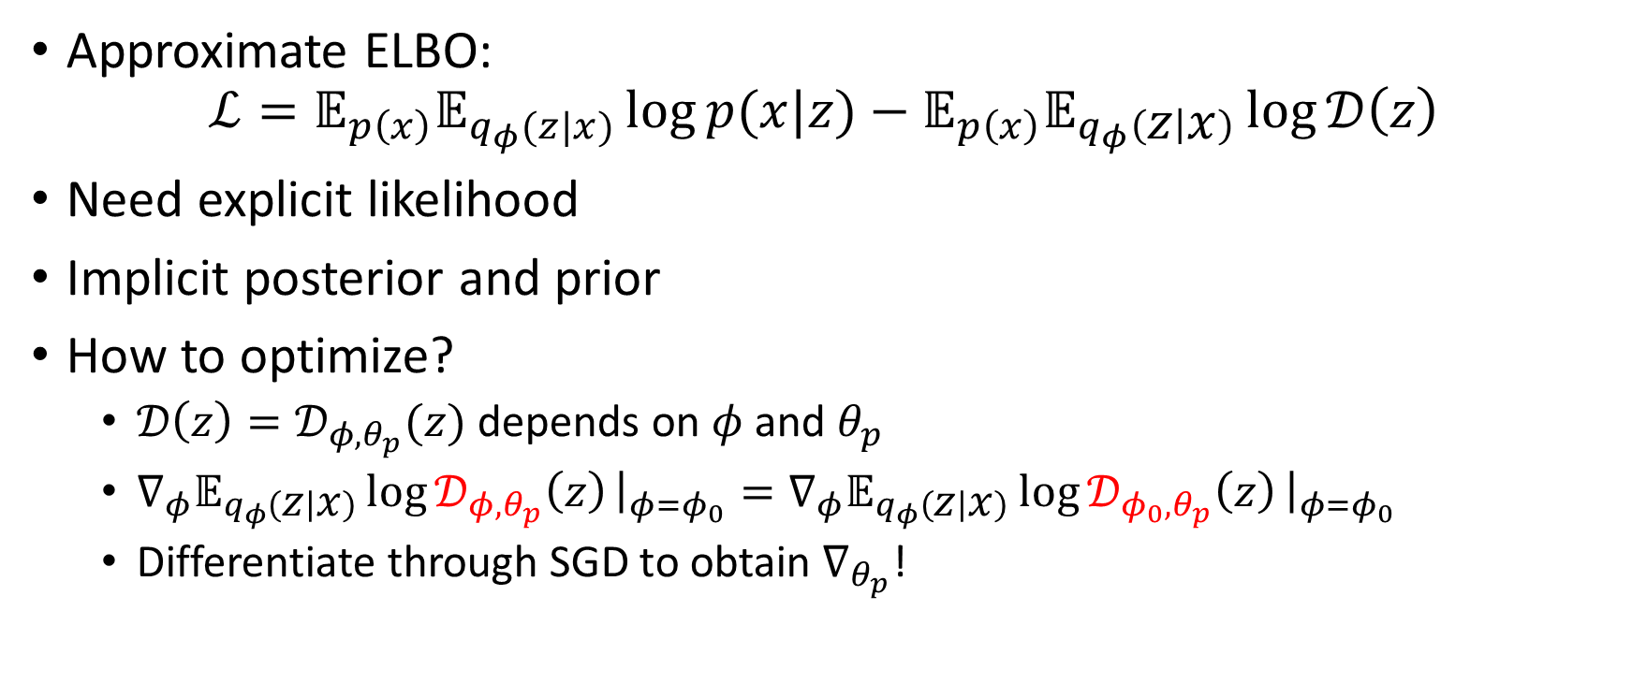
Prior-constrastive adversarial
Approximate ELBO:
$$ℒ=𝔼_{p\left(x\right)}𝔼_{q_{φ}(z|x)}\log{p(x|z)}−𝔼_{p\left(x\right)}𝔼_{q_{φ}\left(z | x\right)}\log{𝒟\left(z\right)}$$
Need explicit likelihood
Implicit posterior and prior
How to optimize?
$𝒟\left(z\right)=𝒟_{φ,θ_{p}}(z)$ depends on $φ$ and $θ_{p}$
$∇_{φ}𝔼_{q_{φ}\left(z | x\right)}\log{𝒟_{φ,θ_{p}}\left(z\right)}{\left.​\right|}_{φ=φ_{0}}=∇_{φ}𝔼_{q_{φ}\left(z | x\right)}\log{𝒟_{φ_{0},θ_{p}}\left(z\right)}{\left.​\right|}_{φ=φ_{0}}$
Differentiate through SGD to obtain $∇_{θ_{p}}$!

Slide 17
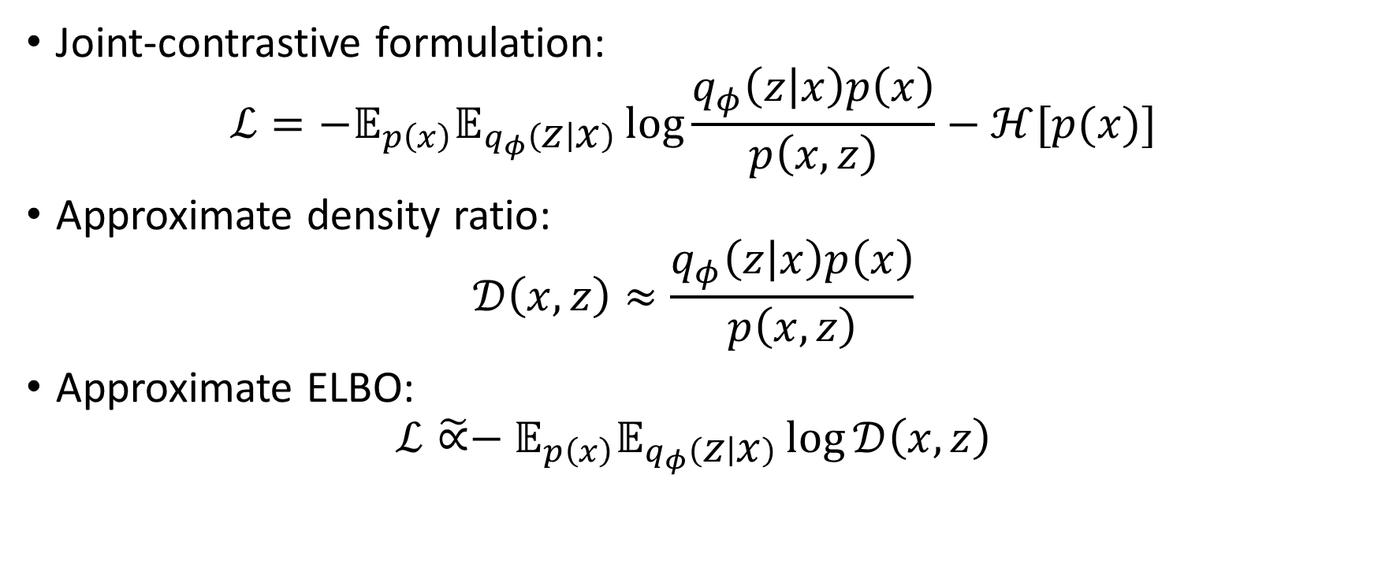
Joint-contrastive adversarial
Joint-contrastive formulation:
$$ℒ=−𝔼_{p\left(x\right)}𝔼_{q_{φ}\left(z | x\right)}\log{\frac{q_{φ}\left(z | x\right)p\left(x\right)}{p\left(x,z\right)}}−ℋ[p(x)]$$
Approximate density ratio:
$$𝒟\left(x,z\right)≈\frac{q_{φ}\left(z | x\right)p\left(x\right)}{p\left(x,z\right)}$$
Approximate ELBO:
$$ℒ\tilde{∝}−𝔼_{p\left(x\right)}𝔼_{q_{φ}\left(z | x\right)}\log{𝒟\left(x,z\right)}$$

Slide 18
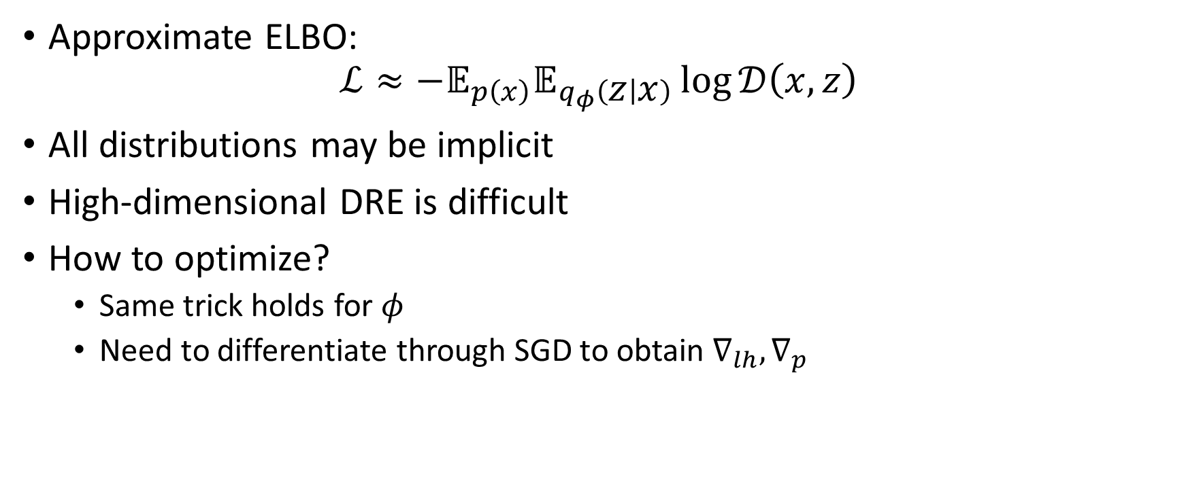
Joint-contrastive adversarial
Approximate ELBO:
$$ℒ≈−𝔼_{p\left(x\right)}𝔼_{q_{φ}\left(z | x\right)}\log{𝒟\left(x,z\right)}$$
All distributions may be implicit
High-dimensional DRE is difficult
How to optimize?
Same trick holds for $φ$
Need to differentiate through SGD to obtain $∇_{lh},∇_{p}$

Slide 19

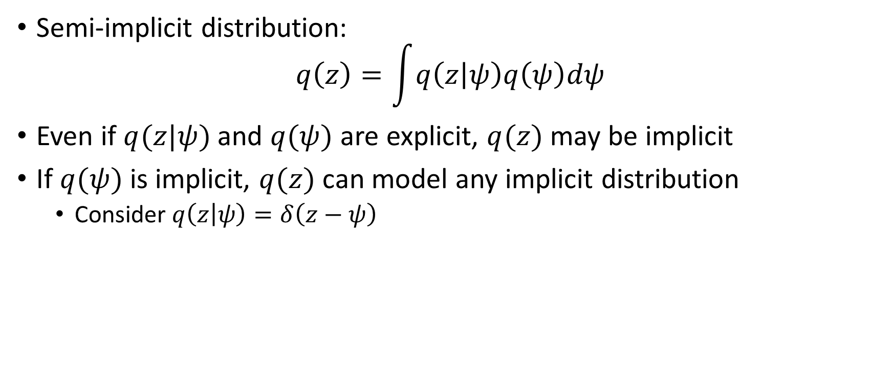



Semi-implicit formulation
Semi-implicit distribution:
$$q\left(z\right)=\int{q\left(z | ψ\right)q\left(ψ\right)dψ}$$
Even if $q(z|ψ)$ and $q(ψ)$ are explicit, $q(z)$ may be implicit
If $q(ψ)$ is implicit, $q(z)$ can model any implicit distribution
Consider $q\left(z | ψ\right)=δ\left(z−ψ\right)$
…
Neural network
Normalizing flow
…
$$ε$$
$$ψ$$
$$z$$
$$\hat{ε}$$

Slide 20

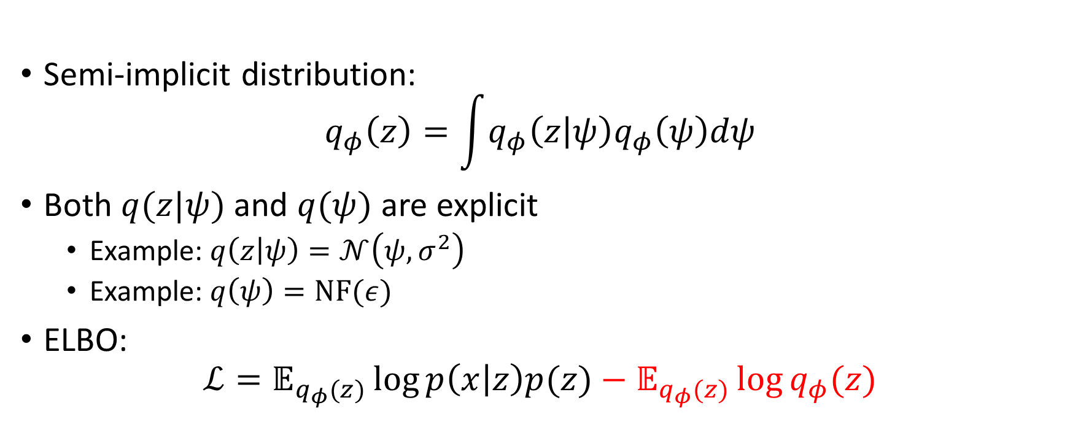



Hierarchical variational inference
Normalizing flow
$$ψ$$
$$ε$$
$$z$$
Semi-implicit distribution:
$$q_{φ}\left(z\right)=\int{q_{φ}\left(z | ψ\right)q_{φ}\left(ψ\right)dψ}$$
Both $q(z|ψ)$ and $q(ψ)$ are explicit
Example: $q\left(z | ψ\right)=𝒩\left(ψ,σ^{2}\right)$
Example: $q\left(ψ\right)=\text{NF}(ε)$
ELBO:
$$ℒ=𝔼_{q_{φ}(z)}\log{p\left(x | z\right)p(z)}−𝔼_{q_{φ}(z)}\log{q_{φ}(z)}$$
$$\hat{ε}$$

Slide 21
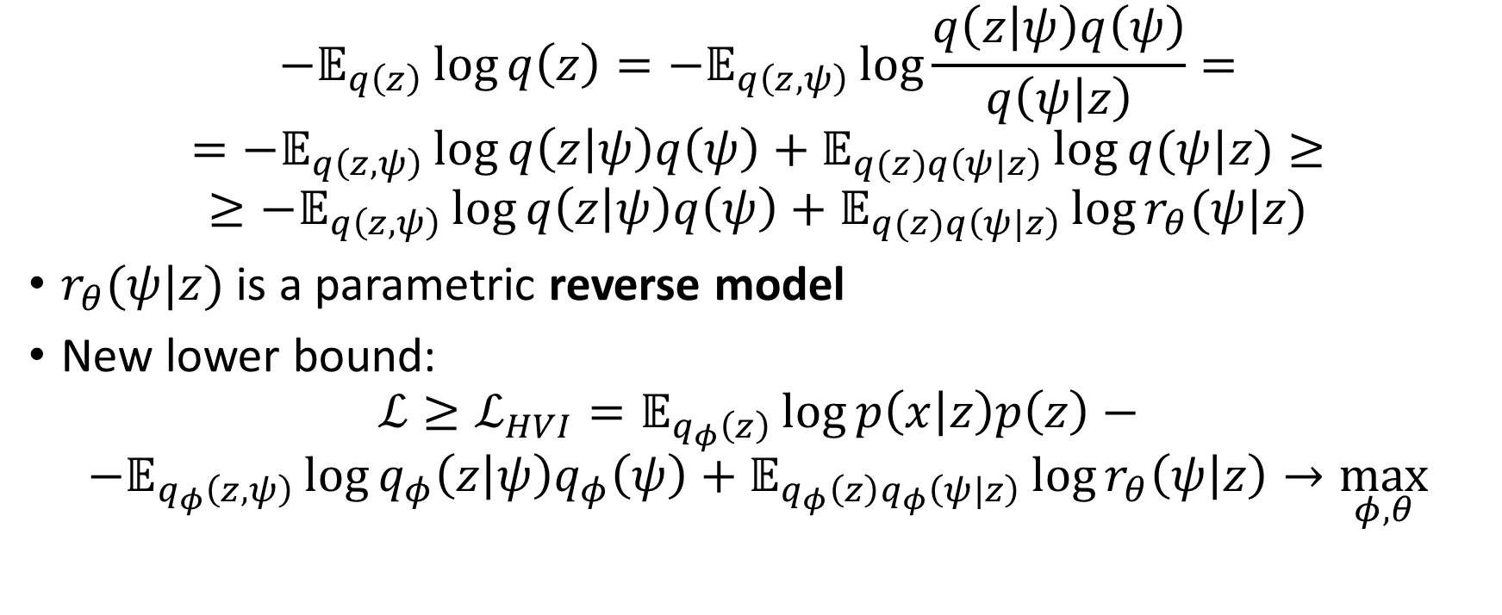
HVI: bounding the entropy
$$−𝔼_{q\left(z\right)}\log{q\left(z\right)}={−𝔼}_{q\left(z,ψ\right)}\log{\frac{q\left(z | ψ\right)q\left(ψ\right)}{q\left(ψ | z\right)}}=$$
$$={−𝔼}_{q\left(z,ψ\right)}\log{q\left(z | ψ\right)q\left(ψ\right)}+𝔼_{q(z)q\left(ψ|z\right)}\log{q(ψ|z)}≥$$
$$≥{−𝔼}_{q\left(z,ψ\right)}\log{q\left(z | ψ\right)q\left(ψ\right)}+𝔼_{q(z)q\left(ψ|z\right)}\log{r_{θ}(ψ|z)}$$
$r_{θ}(ψ|z)$ is a parametric reverse model
New lower bound:
$$ℒ≥ℒ_{HVI}=𝔼_{q_{φ}\left(z\right)}\log{p\left(x | z\right)p\left(z\right)}−$$
$$−𝔼_{q_{φ}\left(z,ψ\right)}\log{q_{φ}\left(z | ψ\right)q_{φ}\left(ψ\right)}+𝔼_{q_{φ}\left(z\right)q_{φ}\left(ψ|z\right)}\log{r_{θ}\left(ψ | z\right)}→\max_{φ,θ}$$

Slide 22
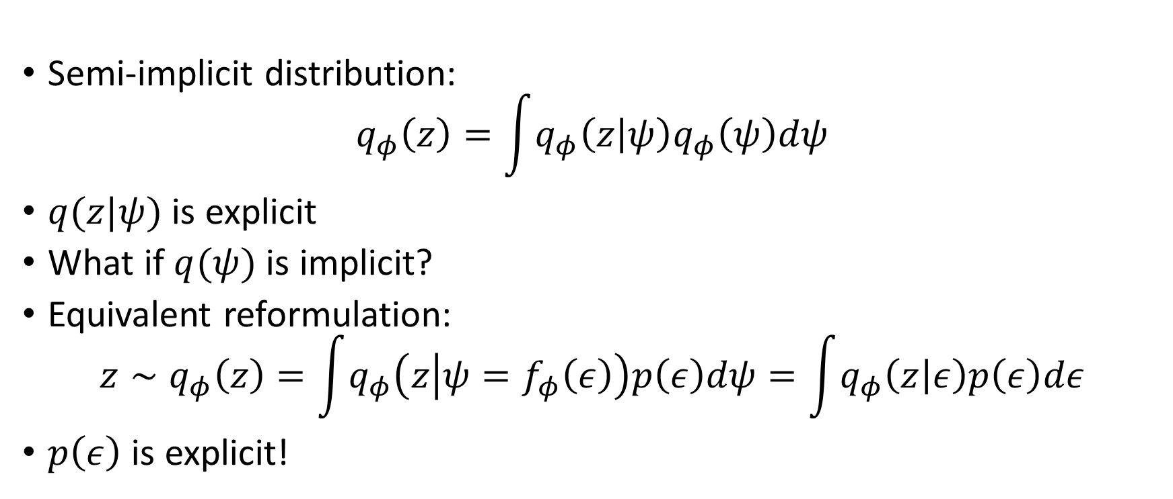
Unbiased implicit variational inference
Neural network
$$ψ$$
$$ε$$
$$z$$
Semi-implicit distribution:
$$q_{φ}\left(z\right)=\int{q_{φ}\left(z | ψ\right)q_{φ}\left(ψ\right)dψ}$$
$q(z|ψ)$ is explicit
What if $q(ψ)$ is implicit?
Equivalent reformulation:
$$z∼q_{φ}\left(z\right)=\int{q_{φ}\left(z | ψ=f_{φ}\left(ε\right)\right)p\left(ε\right)dψ}=\int{q_{φ}\left(z | ε\right)p\left(ε\right)dε}$$
$p\left(ε\right)$ is explicit!
$$\hat{ε}$$

Slide 23
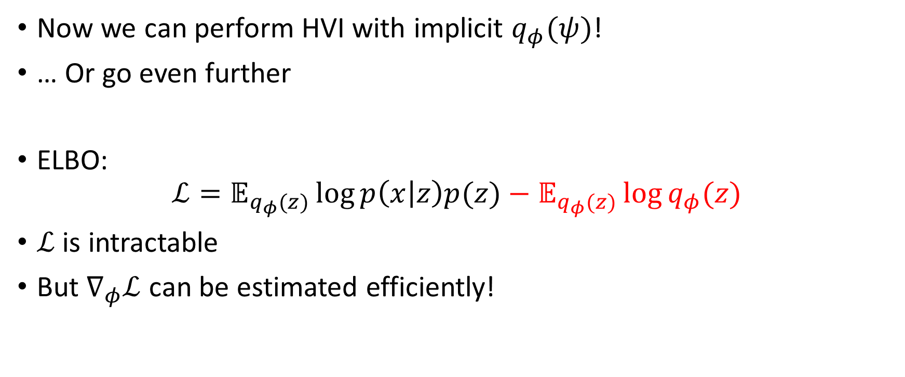
Unbiased implicit variational inference
Now we can perform HVI with implicit $q_{φ}(ψ)$!
… Or go even further
ELBO:
$$ℒ=𝔼_{q_{φ}(z)}\log{p\left(x | z\right)p(z)}−𝔼_{q_{φ}(z)}\log{q_{φ}(z)}$$
$ℒ$ is intractable
But $∇_{φ}ℒ$ can be estimated efficiently!

Slide 24

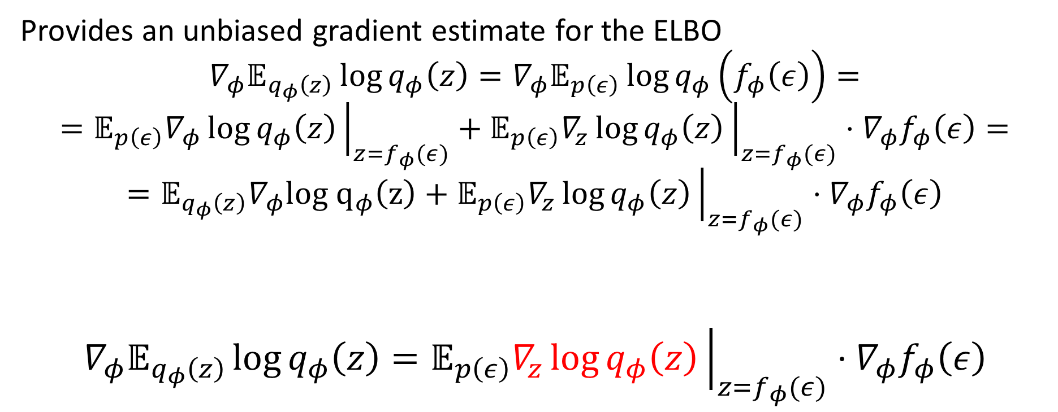
Unbiased implicit variational inference
Provides an unbiased gradient estimate for the ELBO
$$∇_{φ}𝔼_{q_{φ}\left(z\right)}\log{q_{φ}\left(z\right)}=∇_{φ}𝔼_{p\left(ε\right)}\log{q_{φ}\left(f_{φ}\left(ε\right)\right)}=$$
$$=𝔼_{p\left(ε\right)}∇_{φ}\log{q_{φ}\left(z\right)}{\left.​\right|}_{z=f_{φ}(ε)}+𝔼_{p\left(ε\right)}∇_{z}\log{q_{φ}\left(z\right)}{\left.​\right|}_{z=f_{φ}(ε)}⋅∇_{φ}f_{φ}\left(ε\right)=$$
$$=𝔼_{q_{φ}\left(z\right)}∇_{φ}log q_{φ}\left(z\right)+𝔼_{p\left(ε\right)}∇_{z}\log{q_{φ}\left(z\right)}{\left.​\right|}_{z=f_{φ}(ε)}⋅∇_{φ}f_{φ}\left(ε\right)$$
$$∇_{φ}𝔼_{q_{φ}\left(z\right)}\log{q_{φ}\left(z\right)}=𝔼_{p\left(ε\right)}∇_{z}\log{q_{φ}\left(z\right)}{\left.​\right|}_{z=f_{φ}(ε)}⋅∇_{φ}f_{φ}\left(ε\right)$$
$$=0$$

Slide 25
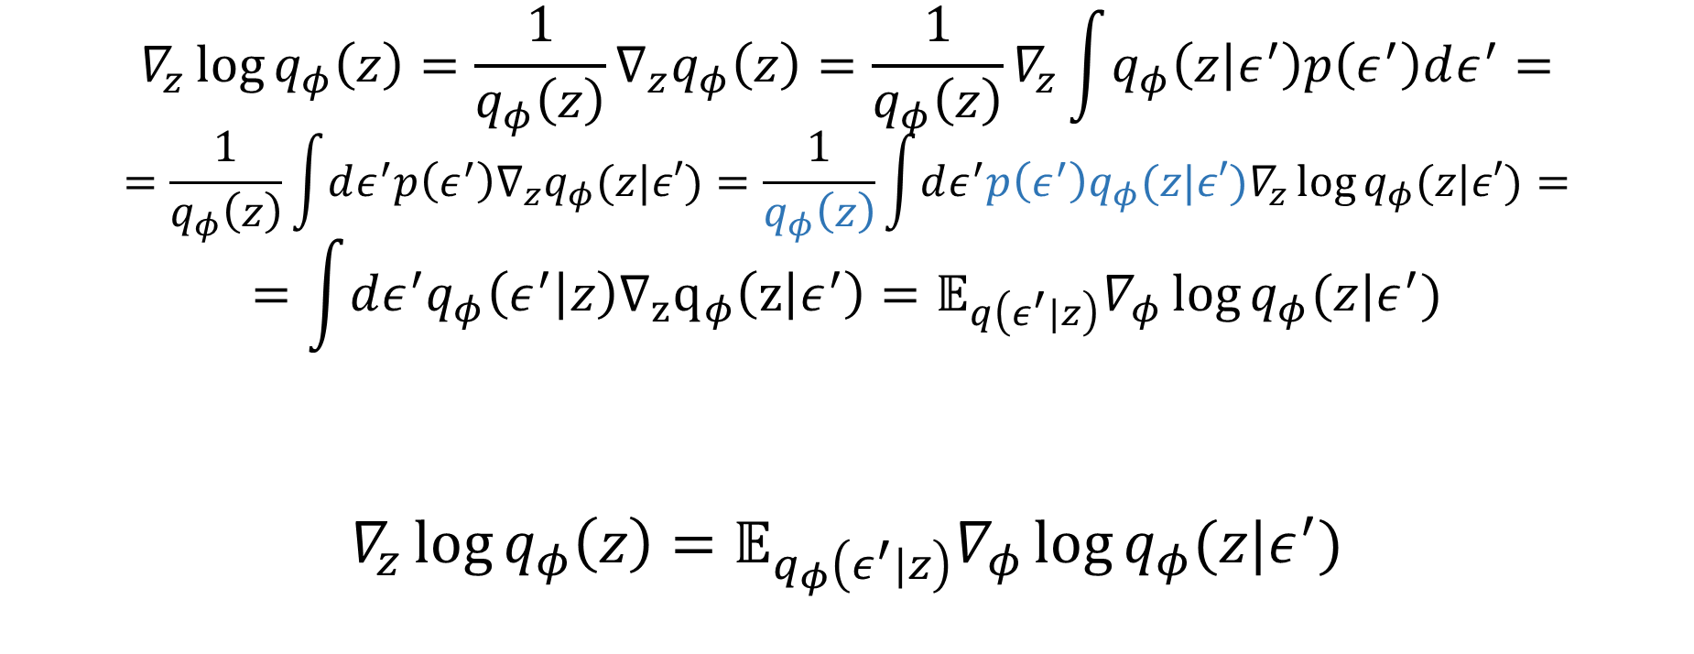
Unbiased implicit variational inference
$$∇_{z}\log{q_{φ}\left(z\right)}=\frac{1}{q_{φ}\left(z\right)}∇_{z}q_{φ}\left(z\right)=\frac{1}{q_{φ}\left(z\right)}∇_{z}\int{q_{φ}\left(z | ε^{′}\right)p\left(ε^{′}\right)dε^{′}}=$$
$$=\frac{1}{q_{φ}\left(z\right)}\int{dε^{′}p\left(ε^{′}\right)∇_{z}q_{φ}(z|ε′)}=\frac{1}{q_{φ}\left(z\right)}\int{dε^{′}p\left(ε^{′}\right)q_{φ}(z|ε′)∇_{z}\log{q_{φ}(z|ε′)}}=$$
$$=\int{dε^{′}q_{φ}\left(ε^{′} | z\right)∇_{z}q_{φ}\left(z | ε^{′}\right)}=𝔼_{q\left(ε^{′}|z\right)}∇_{φ}\log{q_{φ}(z|ε^{′})}$$
$$∇_{z}\log{q_{φ}\left(z\right)}=𝔼_{q_{φ}\left(ε^{′}|z\right)}∇_{φ}\log{q_{φ}(z|ε^{′})}$$

Slide 26
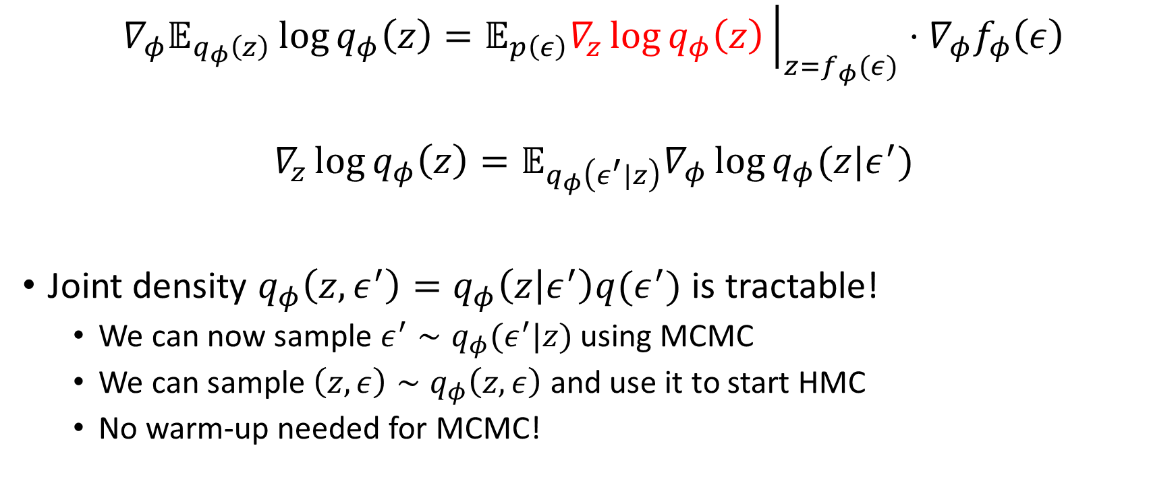
Unbiased implicit variational inference
$$∇_{φ}𝔼_{q_{φ}\left(z\right)}\log{q_{φ}\left(z\right)}=𝔼_{p\left(ε\right)}∇_{z}\log{q_{φ}\left(z\right)}{\left.​\right|}_{z=f_{φ}(ε)}⋅∇_{φ}f_{φ}\left(ε\right)$$
$$∇_{z}\log{q_{φ}\left(z\right)}=𝔼_{q_{φ}\left(ε^{′}|z\right)}∇_{φ}\log{q_{φ}(z|ε^{′})}$$
Joint density $q_{φ}\left(z,ε^{′}\right)=q_{φ}\left(z | ε^{′}\right)q(ε^{′})$ is tractable!
We can now sample $ε^{′}∼q_{φ}(ε^{′}|z)$ using MCMC
We can sample $\left(z, ε\right)∼q_{φ}\left(z,ε\right)$ and use it to start HMC
No warm-up needed for MCMC!

Slide 27
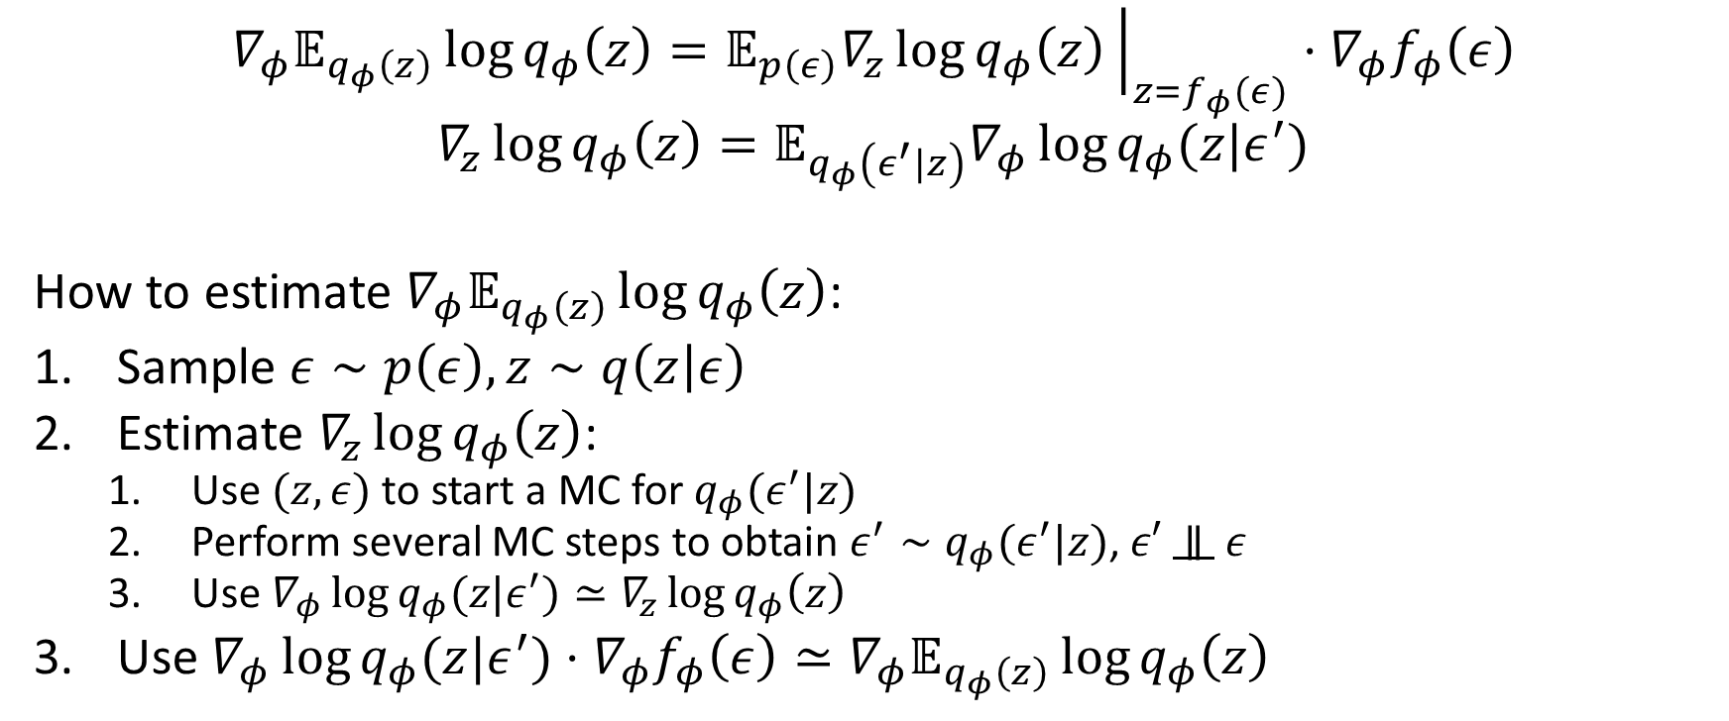
Unbiased implicit variational inference
$$∇_{φ}𝔼_{q_{φ}\left(z\right)}\log{q_{φ}\left(z\right)}=𝔼_{p\left(ε\right)}∇_{z}\log{q_{φ}\left(z\right)}{\left.​\right|}_{z=f_{φ}(ε)}⋅∇_{φ}f_{φ}\left(ε\right)$$
$$∇_{z}\log{q_{φ}\left(z\right)}=𝔼_{q_{φ}\left(ε^{′}|z\right)}∇_{φ}\log{q_{φ}(z|ε^{′})}$$
How to estimate $∇_{φ}𝔼_{q_{φ}\left(z\right)}\log{q_{φ}\left(z\right)}$:
Sample $ε∼p\left(ε\right), z∼q\left(z | ε\right)$
Estimate $∇_{z}\log{q_{φ}\left(z\right)}$:
Use $(z, ε)$ to start a MC for $q_{φ}(ε^{′}|z)$
Perform several MC steps to obtain $ε^{′}∼q_{φ}(ε^{′}|z)$, $ε′$ $∥$ $ε$
Use $∇_{φ}\log{q_{φ}(z|ε^{′})}≃∇_{z}\log{q_{φ}\left(z\right)}$
Use $∇_{φ}\log{q_{φ}(z|ε^{′})}⋅∇_{φ}f_{φ}\left(ε\right)≃∇_{φ}𝔼_{q_{φ}\left(z\right)}\log{q_{φ}\left(z\right)}$

Slide 28
Overview
Density ratio estimation
Prior-contrastive
Joint-contrastive
Any distribution can be made implicit
Variational learning is difficult (need to differentiate through SGD)
Has not been done in this setting?
Stability of DRE is a concern
IVI using reverse models
Relatively simple optimization problem
Less broad applicability
Both HVI and UIVI should extend to implicit priors
Variational learning is not possible

Slide 29
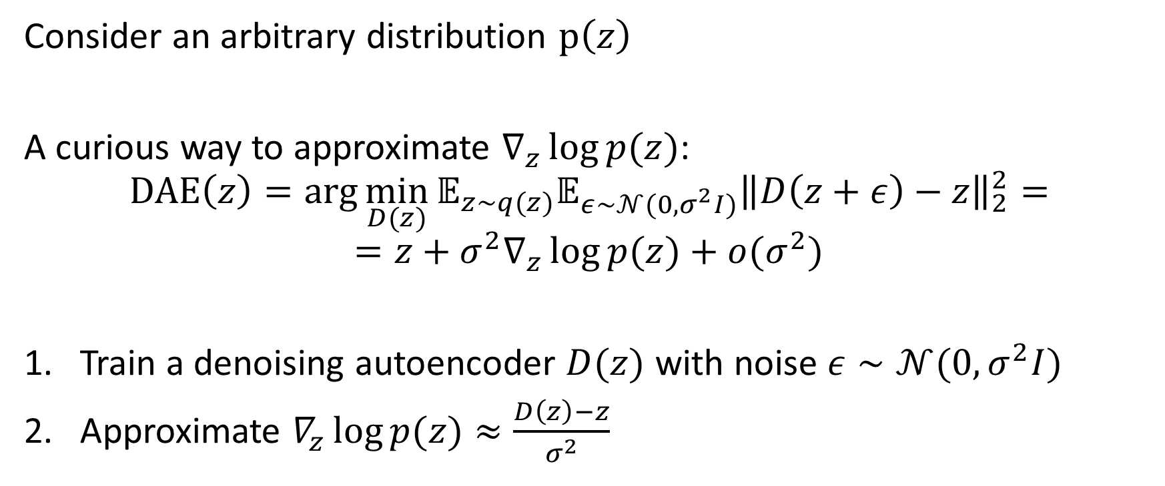
Denoiser-guided learning
Consider an arbitrary distribution $p\left(z\right)$
A curious way to approximate $∇_{z}\log{p(z)}$:
$$\text{DAE}\left(z\right)=\arg{\min_{D(z)}{𝔼_{z∼q(z)}𝔼_{ε∼𝒩(0,σ^{2}I)}{\left\|D\left(z+ε\right)−z\right\|}_{2}^{2}}}=$$
$$=z+σ^{2}∇_{z}\log{p(z)}+o(σ^{2})$$
Train a denoising autoencoder $D(z)$ with noise $ε∼𝒩(0,σ^{2}I)$
Approximate $∇_{z}\log{p(z)}≈\frac{D\left(z\right)−z}{σ^{2}}$

Slide 30
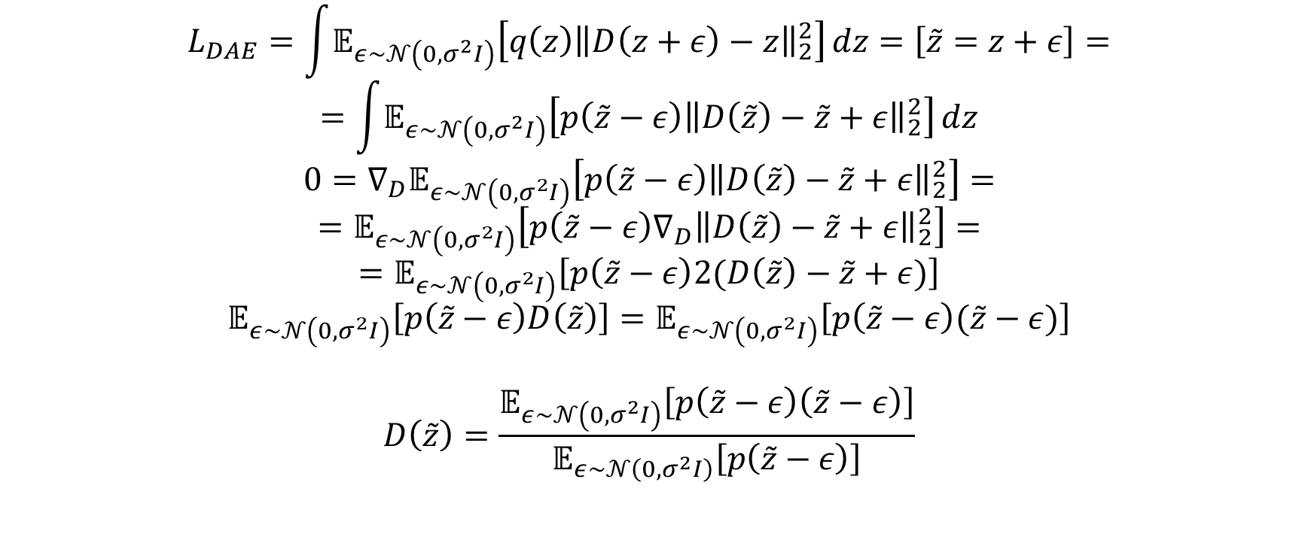
Denoiser-guided learning: optimal denoiser
$$L_{DAE}=\int{𝔼_{ε∼𝒩\left(0,σ^{2}I\right)}\left[q\left(z\right){\left\|D\left(z+ε\right)−z\right\|}_{2}^{2}\right]}dz=\left[\tilde{z}=z+ε\right]=$$
$$=\int{𝔼_{ε∼𝒩\left(0,σ^{2}I\right)}\left[p\left(\tilde{z}−ε\right){\left\|D\left(\tilde{z}\right)−\tilde{z}+ε\right\|}_{2}^{2}\right]}dz$$
$$0=∇_{D}𝔼_{ε∼𝒩\left(0,σ^{2}I\right)}\left[p\left(\tilde{z}−ε\right){\left\|D\left(\tilde{z}\right)−\tilde{z}+ε\right\|}_{2}^{2}\right]=$$
$$=𝔼_{ε∼𝒩\left(0,σ^{2}I\right)}\left[p\left(\tilde{z}−ε\right)∇_{D}{\left\|D\left(\tilde{z}\right)−\tilde{z}+ε\right\|}_{2}^{2}\right]=$$
$$=𝔼_{ε∼𝒩\left(0,σ^{2}I\right)}\left[p\left(\tilde{z}−ε\right)2(D\left(\tilde{z}\right)−\tilde{z}+ε)\right]$$
$$𝔼_{ε∼𝒩\left(0,σ^{2}I\right)}\left[p\left(\tilde{z}−ε\right)D\left(\tilde{z}\right)\right]=𝔼_{ε∼𝒩\left(0,σ^{2}I\right)}\left[p\left(\tilde{z}−ε\right)(\tilde{z}−ε)\right]$$
$$D\left(\tilde{z}\right)=\frac{𝔼_{ε∼𝒩\left(0,σ^{2}I\right)}\left[p\left(\tilde{z}−ε\right)\left(\tilde{z}−ε\right)\right]}{𝔼_{ε∼𝒩\left(0,σ^{2}I\right)}\left[p\left(\tilde{z}−ε\right)\right]}$$

Slide 31
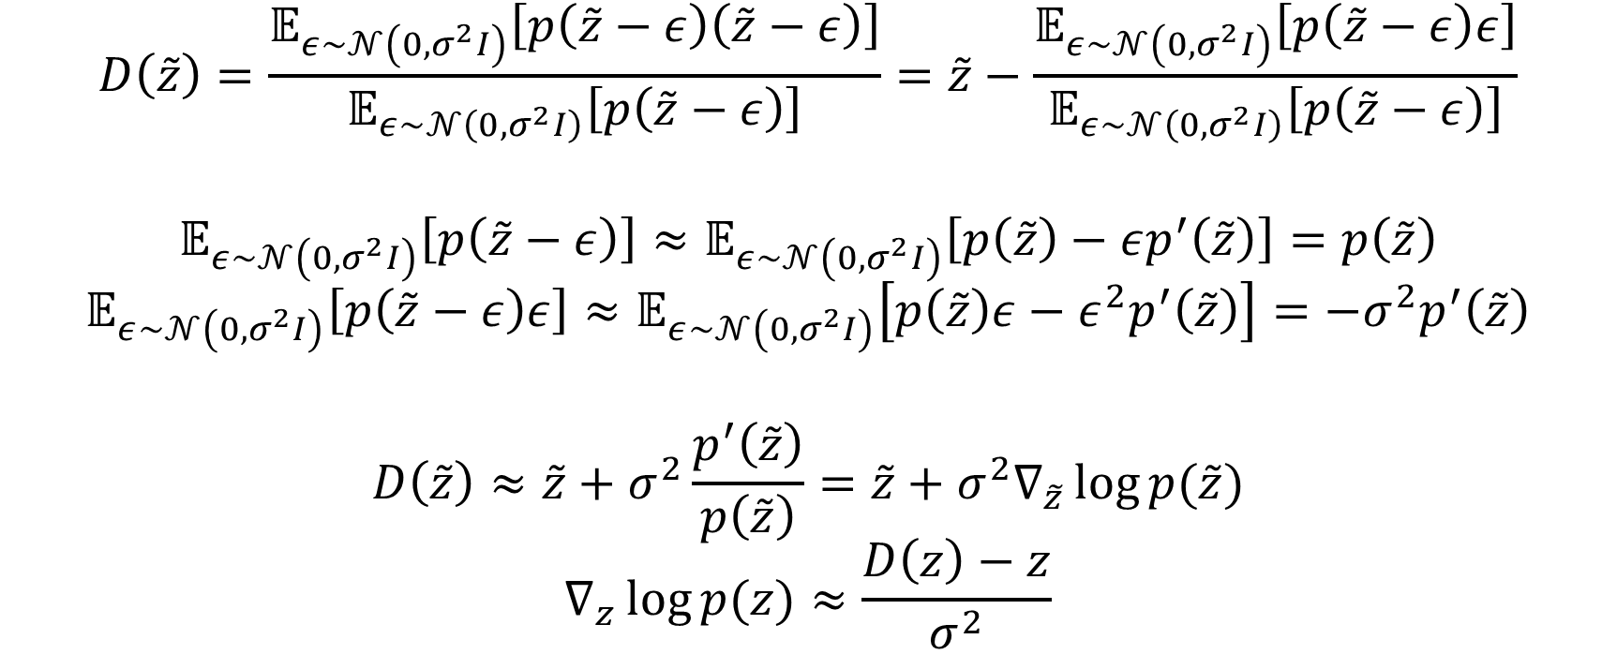
Denoiser-guided learning: intuition
$$D\left(\tilde{z}\right)=\frac{𝔼_{ε∼𝒩\left(0,σ^{2}I\right)}\left[p\left(\tilde{z}−ε\right)\left(\tilde{z}−ε\right)\right]}{𝔼_{ε∼𝒩\left(0,σ^{2}I\right)}\left[p\left(\tilde{z}−ε\right)\right]}=\tilde{z}−\frac{𝔼_{ε∼𝒩\left(0,σ^{2}I\right)}\left[p\left(\tilde{z}−ε\right)ε\right]}{𝔼_{ε∼𝒩\left(0,σ^{2}I\right)}\left[p\left(\tilde{z}−ε\right)\right]}$$
$$𝔼_{ε∼𝒩\left(0,σ^{2}I\right)}\left[p\left(\tilde{z}−ε\right)\right]≈𝔼_{ε∼𝒩\left(0,σ^{2}I\right)}\left[p\left(\tilde{z}\right)−εp^{′}\left(\tilde{z}\right)\right]=p\left(\tilde{z}\right)$$
$$𝔼_{ε∼𝒩\left(0,σ^{2}I\right)}\left[p\left(\tilde{z}−ε\right)ε\right]≈𝔼_{ε∼𝒩\left(0,σ^{2}I\right)}\left[p\left(\tilde{z}\right)ε−ε^{2}p^{′}\left(\tilde{z}\right)\right]=−σ^{2}p^{′}\left(\tilde{z}\right)$$
$$D\left(\tilde{z}\right)≈\tilde{z}+σ^{2}\frac{p^{′}\left(\tilde{z}\right)}{p\left(\tilde{z}\right)}=\tilde{z}+σ^{2}∇_{\tilde{z}}\log{p(\tilde{z})}$$
$$∇_{z}\log{p(z)}≈\frac{D\left(z\right)−z}{σ^{2}}$$

Slide 32
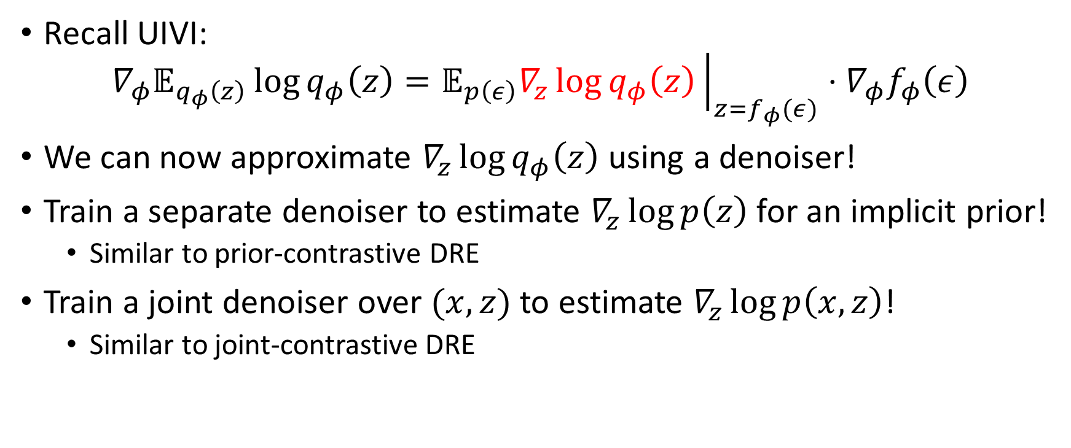
Denoiser-based VI:
Recall UIVI:
$$∇_{φ}𝔼_{q_{φ}\left(z\right)}\log{q_{φ}\left(z\right)}=𝔼_{p\left(ε\right)}∇_{z}\log{q_{φ}\left(z\right)}{\left.​\right|}_{z=f_{φ}(ε)}⋅∇_{φ}f_{φ}\left(ε\right)$$
We can now approximate $∇_{z}\log{q_{φ}\left(z\right)}$ using a denoiser!
Train a separate denoiser to estimate $∇_{z}\log{p\left(z\right)}$ for an implicit prior!
Similar to prior-contrastive DRE
Train a joint denoiser over $(x,z)$ to estimate $∇_{z}\log{p\left(x,z\right)}$!
Similar to joint-contrastive DRE

Slide 33
Literature
Huszár, Ferenc. "Variational inference using implicit distributions." arXiv preprint arXiv:1702.08235 (2017). https://arxiv.org/abs/1702.08235
Ranganath, Rajesh, Dustin Tran, and David Blei. "Hierarchical variational models." International Conference on Machine Learning. 2016. https://arxiv.org/abs/1511.02386
Michalis K. Titsias, Francisco J. R. Ruiz. “Unbiased Implicit Variational Inference.” arXiv preprint arXiv:1808.02078 (2018). https://arxiv.org/abs/1808.02078
Salimans, Tim, Diederik Kingma, and Max Welling. "Markov chain monte carlo and variational inference: Bridging the gap." International Conference on Machine Learning. 2015. https://arxiv.org/abs/1410.6460
Louizos, Christos, and Max Welling. "Multiplicative normalizing flows for variational bayesian neural networks." arXiv preprint arXiv:1703.01961 (2017). https://arxiv.org/abs/1703.01961

